Slide 1
Summarize Group Discussion
PTE Academic updates

Slide 2
Instructions
You will listen to a group discussion between 3 people.
You should take notes while listening.
The topic will be academic.
Once the listening is over, you will have 2 minutes to speak and summarize the discussion.

Slide 3
IMPORTANT NOTE: 15-16 for speaking and listening Here is the transcript of a Summarize Group Discussion audio. You will not see this when listening. You will hear the audio once.
Notes:
PTE Academic updates

Slide 4
Module | Question Type | Speaking | Writing | Reading | Listening
Speaking | Read Aloud (RA) | 7.52 |  |  | 13.36
 | Repeat Sentence (RS) | 12.48
 | Describe Image (DI) | 25.4
 | Retell Lecture (RL) | 10 |  |  | 10.64
 | Answer Short Question (ASQ) |  |  |  | 3.36
 | Summarize Group Discussion (SGD) | 15.04 |  |  | 16
 | Respond to a Situation (RTS) | 10
Writing | Summarize Written Text (SWT) |  | 22.16 | 18
 | Writing Essay (WE) |  | 24.64
Reading | Fill in the Blanks (Dropdown) (FIB Dropdown) |  |  | 22
 | Multiple Choice, Multiple Answers (MCQ MA) |  |  | 4
 | Reorder Paragraph (ROP) |  |  | 7.04
 | Fill in the Blanks (Drag & Drop) FIB (Drag & Drop) |  |  | 15.04
 | Multiple Choice, Single Answer (MCQ SA) |  |  | 2
Listening | Summarize Spoken Text (SST) |  |  |  | 14.8
 | Multiple Choice, Multiple Answers (MCQ MA) |  |  |  | 2.64
 | Fill in the Blanks (FIB Type) |  |  |  | 6
 | Highlight Correct Summary (HCS) |  |  | 2 | 1.36
 | Multiple Choice, Single Answer (MCQ SA) |  |  | 1.36
 | Select Missing Words (SMW) |  |  | 0.64
 | Highlight Incorrect Words (HIW) |  |  | 6.64
 | Write From Dictation (WFD) |  | 18.48 | 10 | 10

Slide 5
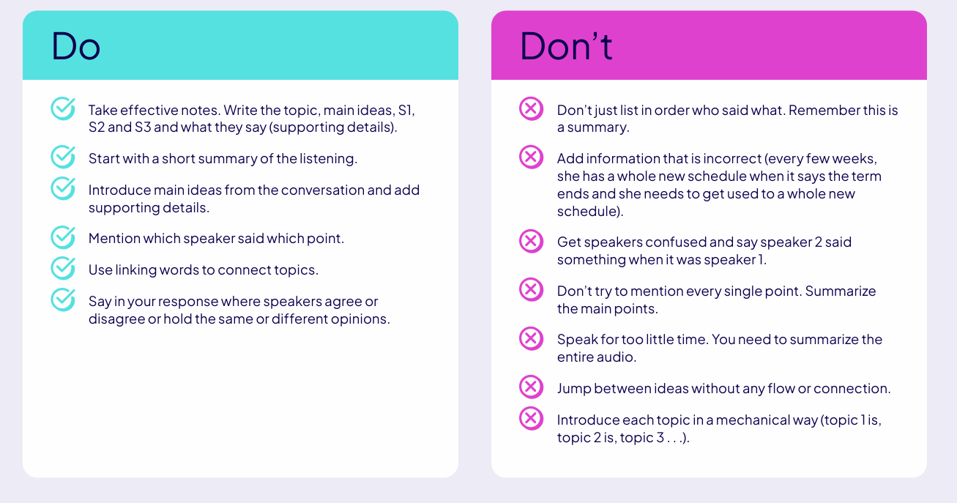

Slide 6
Template for it
So, in this conversation, the three presenters talked about topic.
They expressed their particular experiences and problems on main keyword.
The first speaker focused mostly on how difficult it may be on keyword. They started that they wanted keyword.

Slide 7
PLUGIN-TEMPLATES
In comparison, Speaker A focused on the advantages of [KEYWORD], while Speaker B highlighted its disadvantages.
While Speaker A emphasized [KEYWORD], Speaker C presented a contrasting viewpoint on the same matter.
Both Speaker A and B discussed [TOPIC], but with different perspectives: A supported [KEYWORD], whereas B argued for [KEYWORD].
Comparatively, Speaker A believed [KEYWORD], while Speaker C believed [KEYWORD].

Slide 8
Contrast / Disagreement
Speaker A disagreed with Speaker B’s point on [KEYWORD], suggesting that [CONTRASTING KEYWORD].
While Speaker B supported [KEYWORD], Speaker C opposed it, citing concerns over [ISSUE].
There was a clear contradiction between Speaker A’s optimism and Speaker C’s criticism regarding [TOPIC].
Speaker A and Speaker C held opposing views: one promoting [KEYWORD], the other warning about its consequences.

Slide 9
Agreement For common/shared opinions among speakers.
All speakers agreed that [COMMON KEYWORD] plays a vital role in [TOPIC].
Despite differing in details, the speakers reached consensus on the importance of [KEYWORD].
There was unanimous agreement on [KEYWORD], even though the reasons differed.
All participants acknowledged that [KEYWORD] is essential for [TOPIC].

Slide 10
When presenting individual speaker opinions.
Speaker A emphasized [KEYWORD] as a solution to [PROBLEM].
Speaker C questioned the effectiveness of [KEYWORD], calling for alternative approaches.
According to Speaker B, [KEYWORD] could improve [AREA].
Speaker A firmly believed that [KEYWORD] outweighs the risks of [OTHER KEYWORD].

Slide 11
Conclusion
In conclusion, Speaker A and B focused on the benefits of [TOPIC], whereas Speaker C discussed its limitations.
To sum up, while some speakers favored [KEYWORD], others highlighted its shortcomings, leading to a balanced viewpoint.
The discussion concluded with mixed opinions: some emphasized the advantages, while others stressed the risks.
Ultimately, the group reached a tentative conclusion that [FINAL KEYWORD] may offer the most effective solution.

Slide 12
The conversation included a wide spectrum of ideas. To begin, Speaker A brought attention to (insert essential idea), emphasizing its significance for (insert topic). Following that, Speaker B attacked the problem from a different angle, pointing out that (insert contrast/other keyword) might be more practical or important. Meanwhile, Speaker C seemed to be more concerned about (insert risk, downside, or constraint), which added dimension to the conversation. Interestingly, despite their differing perspectives, they all touched on essential aspects of (insert issue). It was clear by the end of the conversation that both keywords were present, which made the topic more well-rounded and motivating/any related keyword.

Slide 13
Variable | Replace with...
(insert key idea) | The main point from Speaker A
(insert topic) | General topic of discussion
(contrast keyword) | Opposing idea or example
(risk/drawback) | Concern, issue, or limitation

Slide 14
The discussion explored how university life compares to initial expectations, with each speaker bringing unique experiences. To begin with, one student reflected on the academic load, noting that the intense workload, especially in science and technology courses, was far more demanding than imagined — quite different from the fun-filled college life often shown in movies. Another speaker added a more positive note, appreciating the surprisingly vibrant social scene and the chance to build a sense of community by joining clubs and meeting diverse people. Meanwhile, a third participant focused on the lack of flexibility in academic choices, expressing that the structured schedules and required classes limited the self-guided learning they had hoped for. Despite these differing perspectives, they all agreed that the transition involved unexpected challenges and valuable personal growth. In the end, the conversation painted a picture of university life that is more complex than expected, blending academic pressure, evolving independence, and gradual adaptation into a richer, more realistic experience.

Slide 15
Respond to a Situation
Instructions
You will read and listen to a prompt giving you instructions for the situation.
You can take notes as you listen to the prompt but you have limited time to do this.
After the audio ends, you will need to respond to the situation in 40 seconds, 60 seconds to speak

Slide 16
Template structure
Greeting
Acknowledge the Situation
Empathy/Engagement
Main Response/Solution
Extra Tip or Clarification
Closing

Slide 17
Tips
Keep tone polite and conversational
Avoid long pauses or filler words
Use contractions for natural flow (e.g., "I’ll", "That’s")
If unsure, generalize positively

Slide 18
Fluency Plug-ins (insert into response to sound natural)
Actually, I think the best way would be to...
What I’d recommend is...
That’s definitely a concern, and I hear you...
Just to add on...
If you’d like, I can also...

Slide 19
You are working on a group presentation for class, and your teammates just decided on the order of presenters. They want you to go first, but you feel unprepared and think it would be better to go later. You’re in a meeting with your group now. What do you say to your teammates?

Slide 20
🔑 Keyword Type | 💡 Examples
Situation Keyword | "preparing for an interview", "stressed about deadlines", "planning a trip"
Goal/Concern Keyword | "some help", "some suggestions", "feedback", "a quick opinion"
Emotional Keyword | "challenging", "understandable", "exciting", "frustrating"
Empathy Keyword | "understand", "appreciate", "relate to", "see where you're coming from"
Action Keyword | "taking short breaks", "practicing mock interviews", "using a checklist"
Supporting Reason | "it helps reduce stress", "you’ll feel more prepared", "it saves time"
Second Tip Keyword | "setting reminders", "using an app", "talking to a friend", "planning ahead"
Concern/Topic Keyword | "study habits", "English practice", "budgeting", "time management"

Slide 21
Practice prompt
You are doing a group project for a class. The other members of your group have asked you to prepare the slides for the presentation. You are willing to do the slides but need them to give you all the information that you have to include before the weekend. What would you say to them?

Slide 22
Hi, this is Safal. Thanks for calling. I understand you’re preparing for an interview and you’re looking for some help with confidence. That sounds a bit nerve-wracking, and I totally get how you’re feeling. In this case, I’d recommend recording yourself practicing — it helps you hear and refine your answers. Another helpful tip would be to simulate a real interview with a friend. If you need more help with interview techniques, feel free to ask. Thanks again, and good luck!

Slide 23
Speak naturally — use contractions (e.g., "you’re", "I’d", "it’s").
Adjust tone to suit the context (friendly, supportive, polite).
Practice inserting different keywords for various situations to build fluency.

Slide 24
Hi [Name/Everyone], I really appreciate your idea/suggestion.
I just wanted to share my thoughts — I’m not fully ready for this right now If it’s possible, could we make a slight adjustment to it?
In my view, that will allow me to perform better and assist the team more effectively.
Thanks a lot for understanding!
Notes:
Red- based on condition
Thought – keywords related to the scenario

Slide 25
Hi everyone, thanks for deciding the order. I just feel I need a little more time to prepare before going first. If it’s okay, can I go a bit later? I’ll be more confident and support the team better that way. Thanks for understanding!

Slide 26
Hi [Name/Team/Everyone], thanks for [decision/suggestion/discussion about insert topic]. I really appreciate it. I just wanted to share that I’m feeling a bit insert feeling (e.g., unprepared, unsure, overwhelmed) about insert specific task/situation. If possible, could we insert preferred option or small request instead? In my view, that will allow me to perform better and assist the team more effectively.
Thanks a lot for understanding!

Slide 27
Type | Examples
Topic | presentation, meeting, project roles, speaking part
Feeling | unprepared, nervous, overwhelmed, unsure
Request | go later, switch parts, take more time, get help
Alternative Option | go second, meet after class, review notes first

Slide 28
Hi everyone, thanks for organizing the presenter order. I really appreciate it. I just feel a bit unprepared about going first in the presentation. If possible, could I go second or third instead? I think I’ll be more confident and do a better job that way. Thanks so much for understanding!

Slide 29
